Slide 1

Constructing Multiethnic Germany:
Narratives on the German National Football Teams from 2006 to 2018
Titi Kou-Herrema
Michigan State University & Leipzig University
15.3.2023

Slide 2
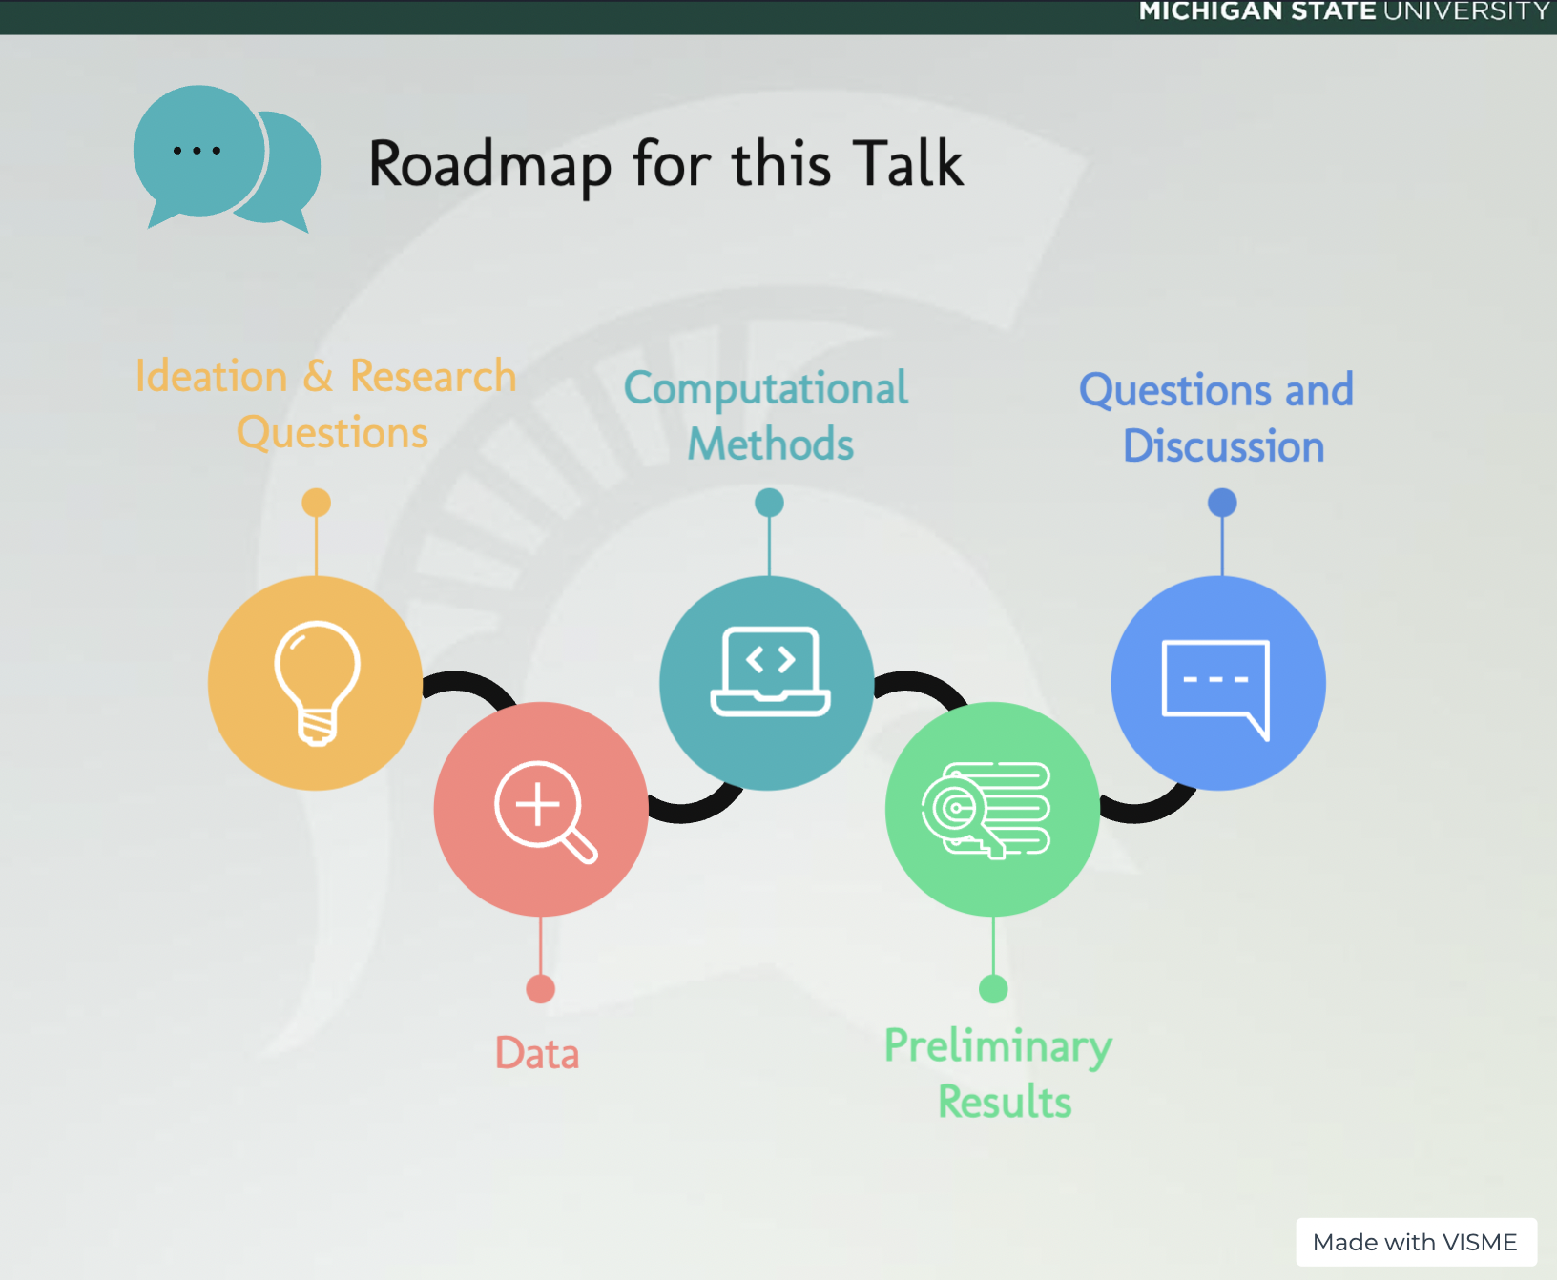

Slide 3
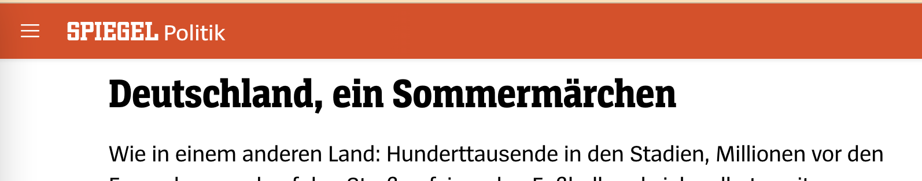
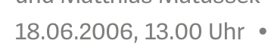
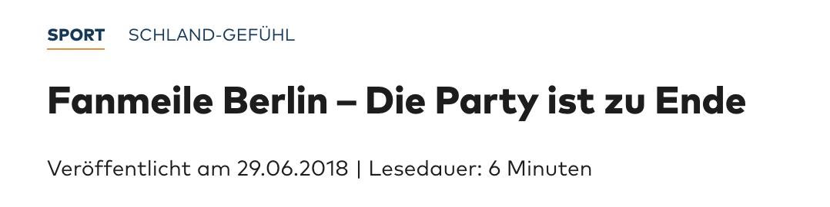
1. Ideation and Research Questions

Slide 4

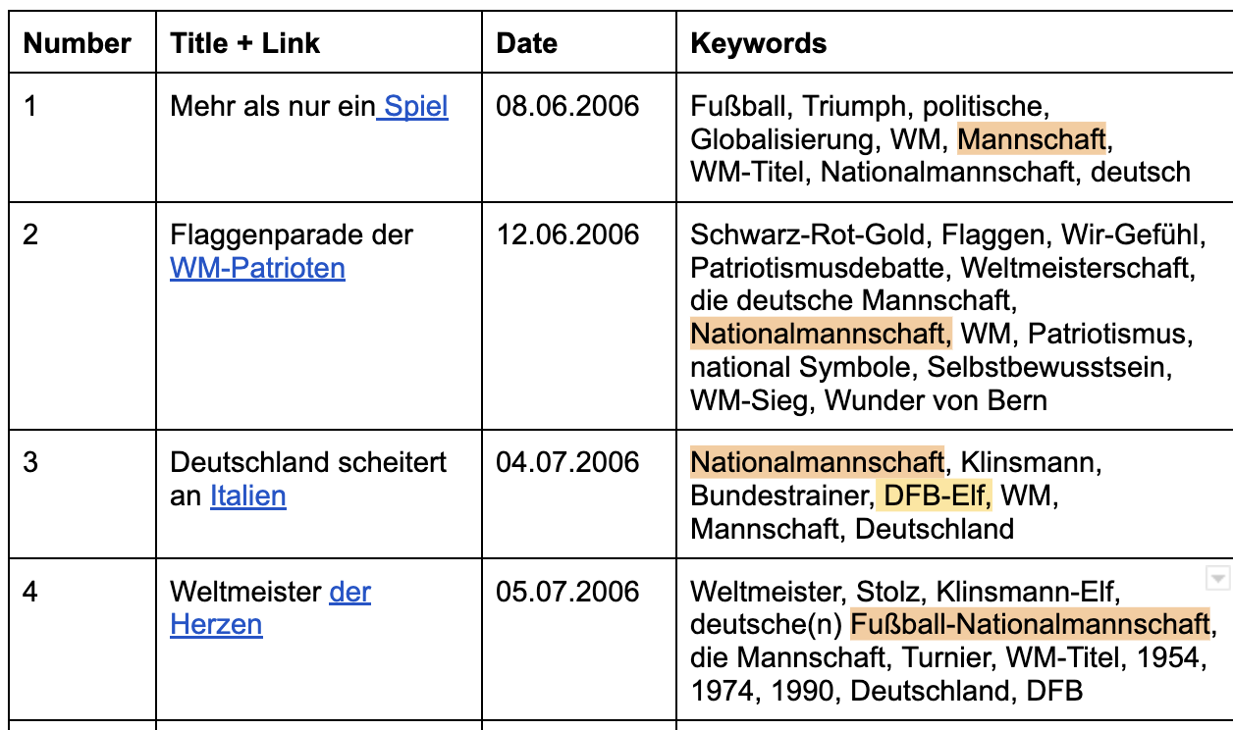
2. Data

Slide 5
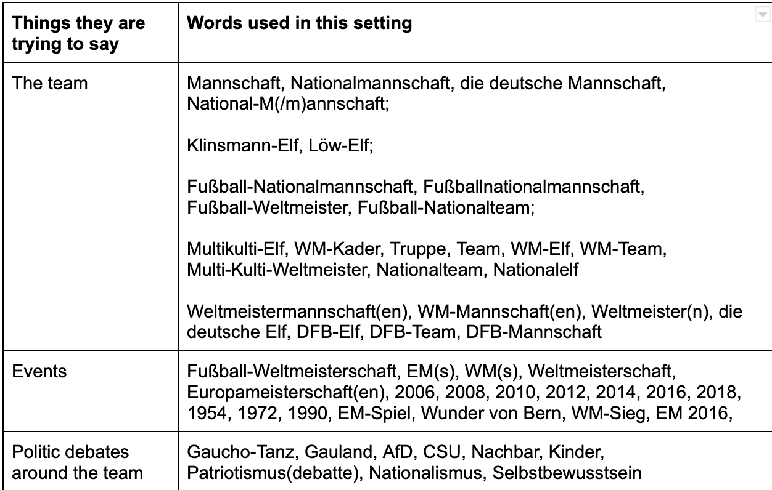
2. Data

Slide 6
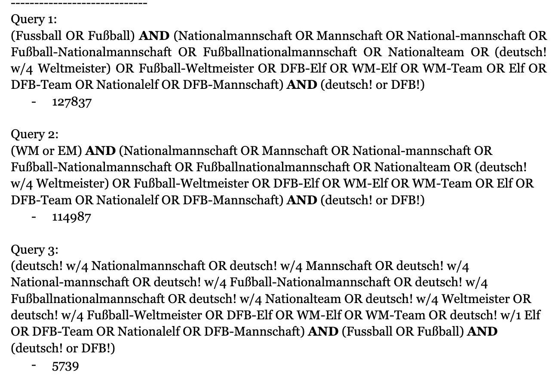
2. Data

Slide 7
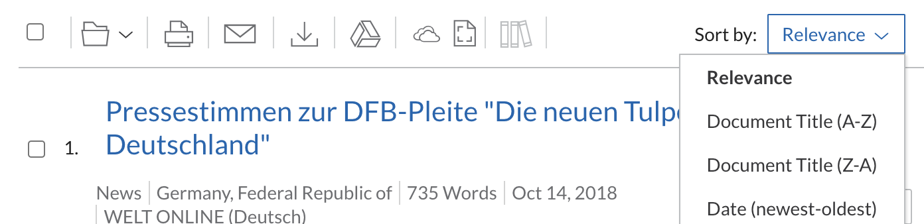
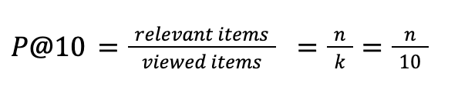
2. Data

Slide 8
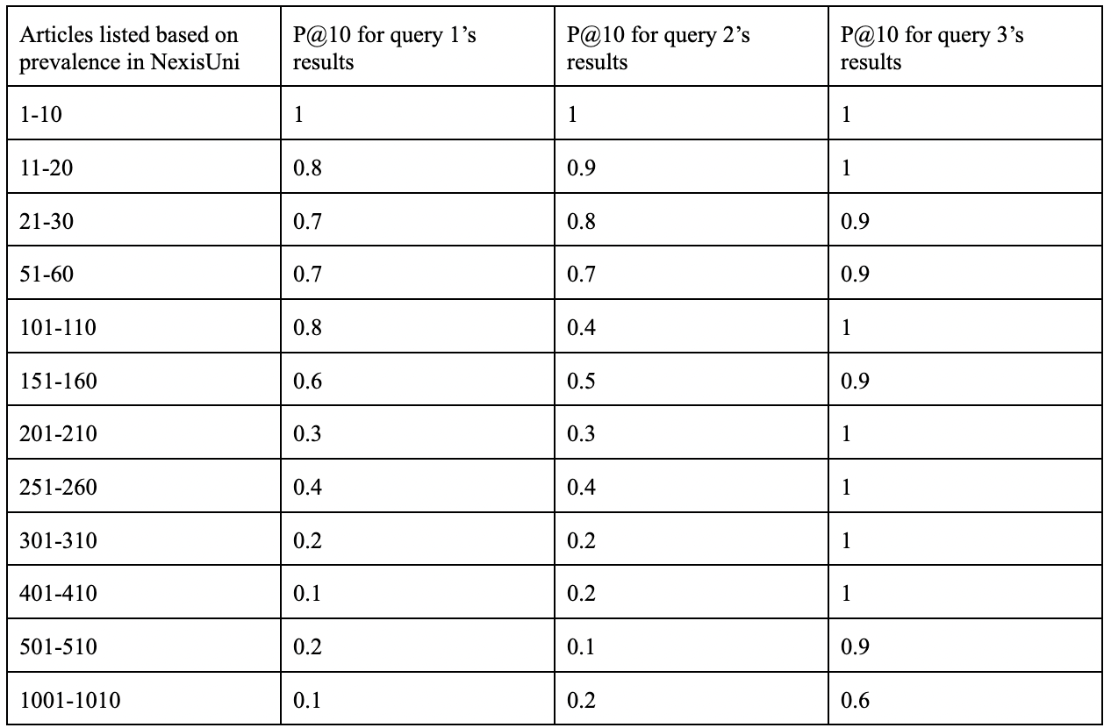

Slide 9
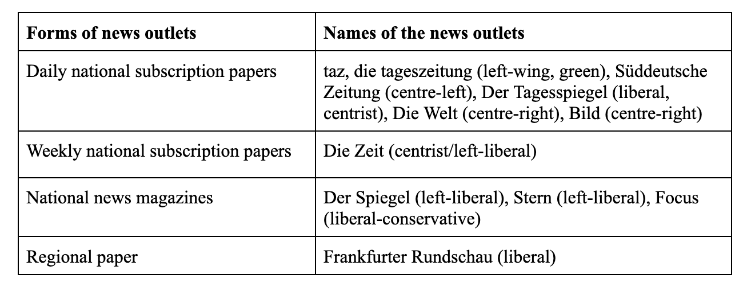
2. Data

Slide 10


3. Methods
Deduplication: MinHash → 5000 articles
Part-0f-speech (POS) tagging
Tokenization and Lemmatization
Switching to lowercase and also removing punctuations, numbers, symbols, and stopwords

Slide 11
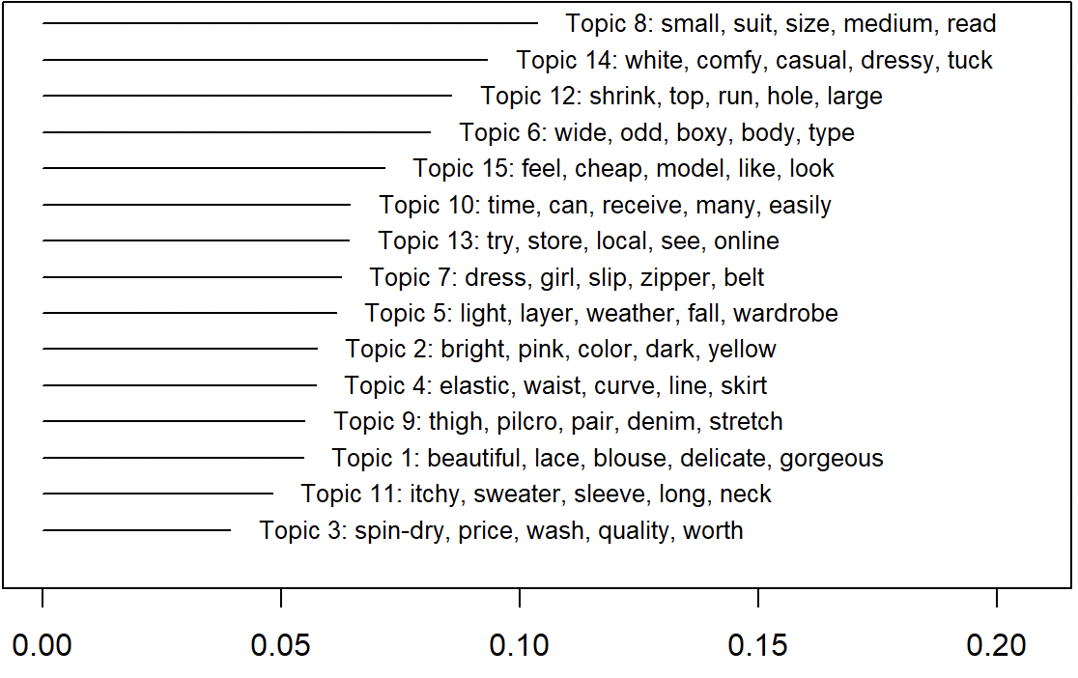
3. Methods
DTM: Document Term Metrics
Searching for the most appropriate number of topics
LDA (Latent Dirichlet Allocation) → STM (Structural Topic Models)

Slide 12
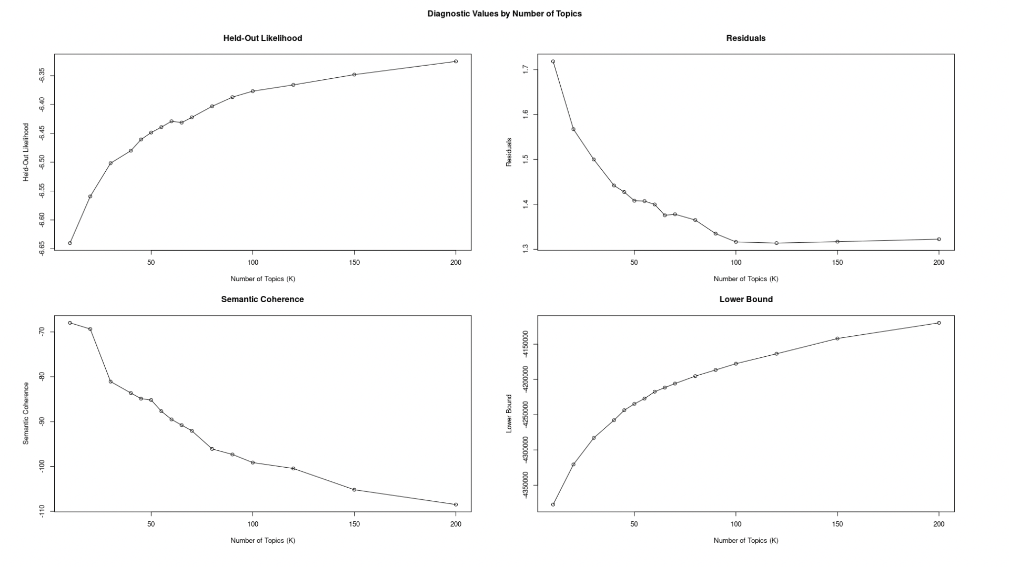
4. Preliminary Results

Slide 13
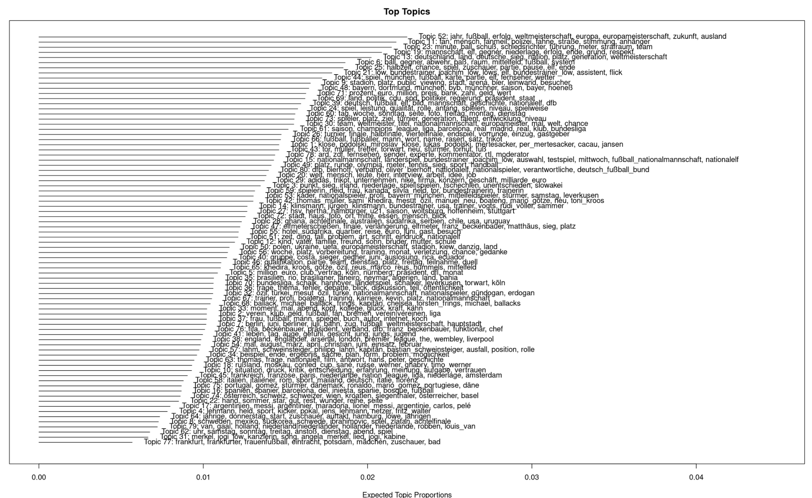
4. Preliminary Results - Topics

Slide 14
4. Preliminary Results - Top Topics
Topic 52: jahr, fußball, erfolg, weltmeisterschaft, europa, europameisterschaft, zukunft, ausland
Topic 11: fan, mensch, fanmeil, polizei, fahne, straße, stimmung, anhänger
Topic 23: minute, ball, schuß, schiedsrichter, führung, meter, strafraum, team
Topic 19: mannschaft, elf, gegner, niederlage, erfolg, ende, grund, respekt
Topic 13: deutschland, land, deutsche, sieg, nation, platz, generation, weltmeisterschaft
Topic 6: ball, gegner, abwehr, paß, raum, mittelfeld, fußball, system
Topic 25: halbzeit, chance, spiel, zuschauer, partie, pause, elf, ende
Topic 21: löw, bundestrainer, joachim_löw, löws, elf, bundestrainer_löw, assistent, flick
Topic 44: spiel, münchen, fußball, karte, partie, elf, fernseher, wetter
Topic 9: stadion, platz, public, viewing, stadt, arena, bier, leinwand, besucher

Slide 15
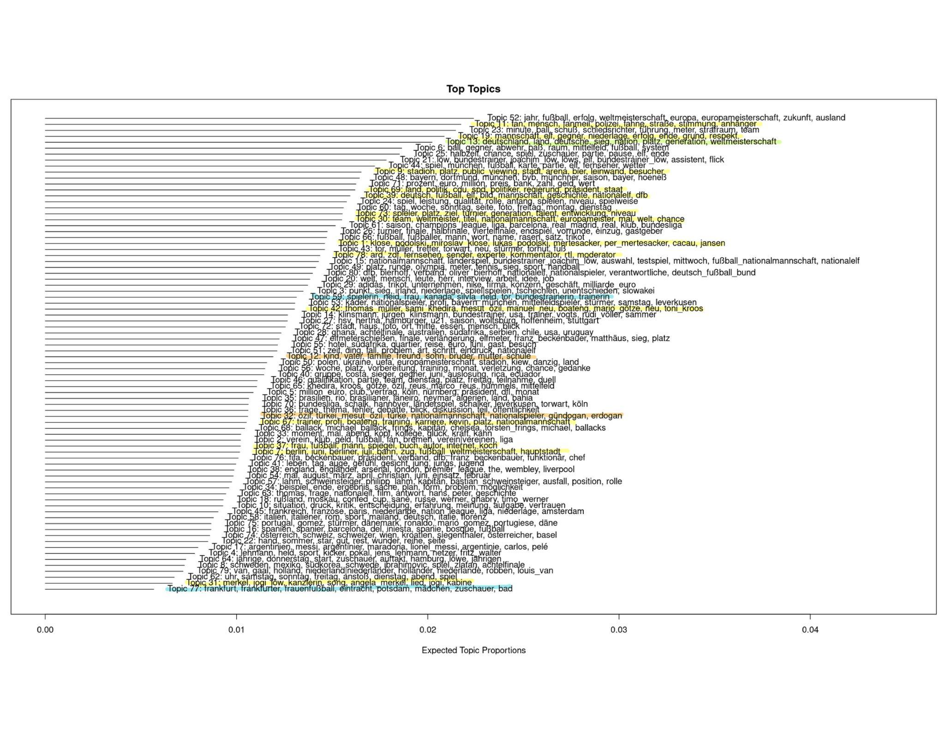
4. Preliminary Results - Topics

Slide 16
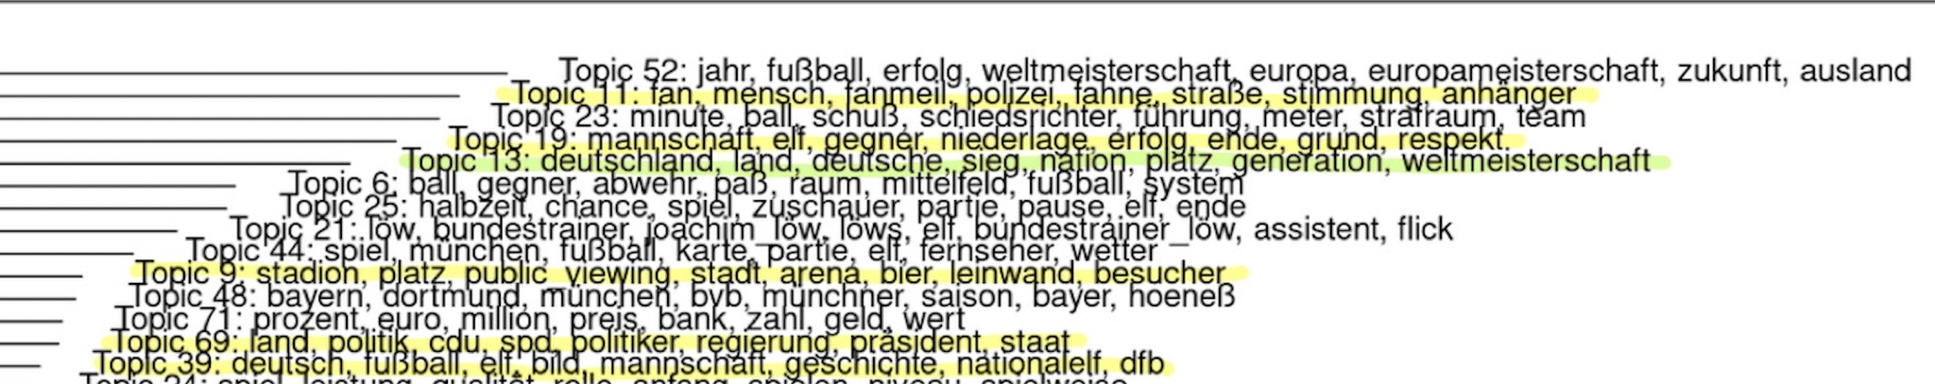

4. Preliminary Results - Interesting Topics

Slide 17
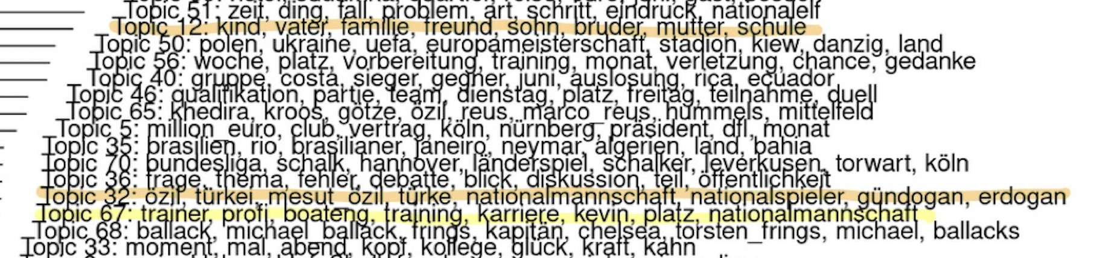

4. Preliminary Results - Interesting Topics

Slide 18

4. Preliminary Results - Interesting Topics

Slide 19
4. Preliminary Results - “Migra*”
Top 10 Topics correlate to “Migra*”
Topic | Values
1 Topics 32 türkei türke erdogan mesut özil | 8.52e- 3
2 Topics 69 spd cdu regierung grüne staat | 2.21e- 4
3 Topics 12 kind vater sohn mutter bruder | 1.32e-13
4 Topics 77 frankfurt frankfurter eintracht frauenfußball potsdam | 2.66e-17
5 Topics 13 deutschland deutsche land nation generation | 2.25e-20
6 Topics 5 club million_euro dfl nürnberg vertrag | 3.19e-23
7 Topics 20 leute welt herr nein warum | 1.67e-24
8 Topics 63 thomas film antwort grieche mail | 6.15e-25
9 Topics 37 frau spiegel autor buch koch | 5.13e-25
10 Topics 72 museum ausstellung gemeinde kunst simon | 1.29e-25

Slide 20
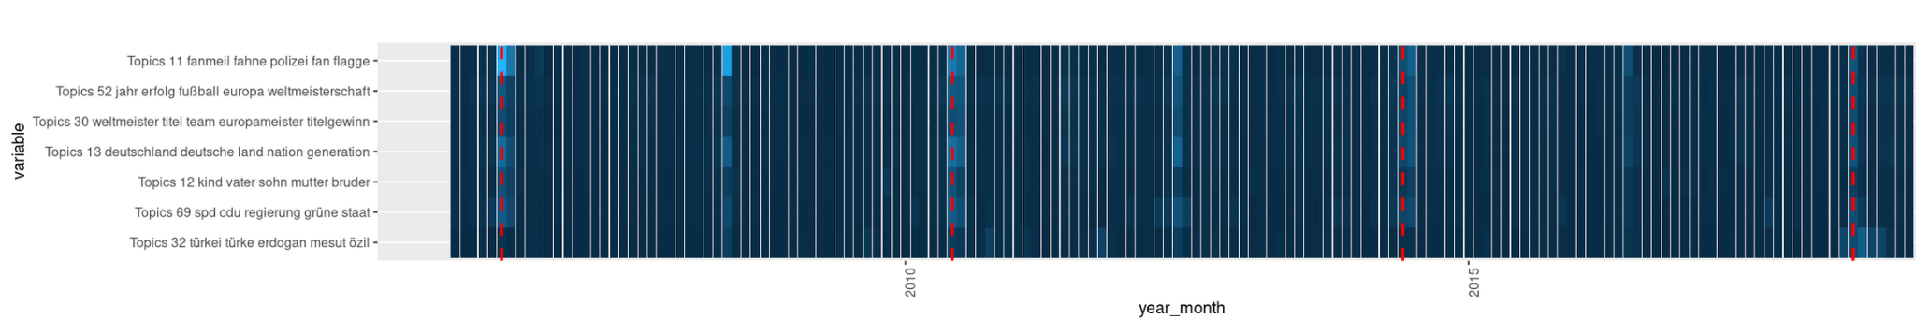
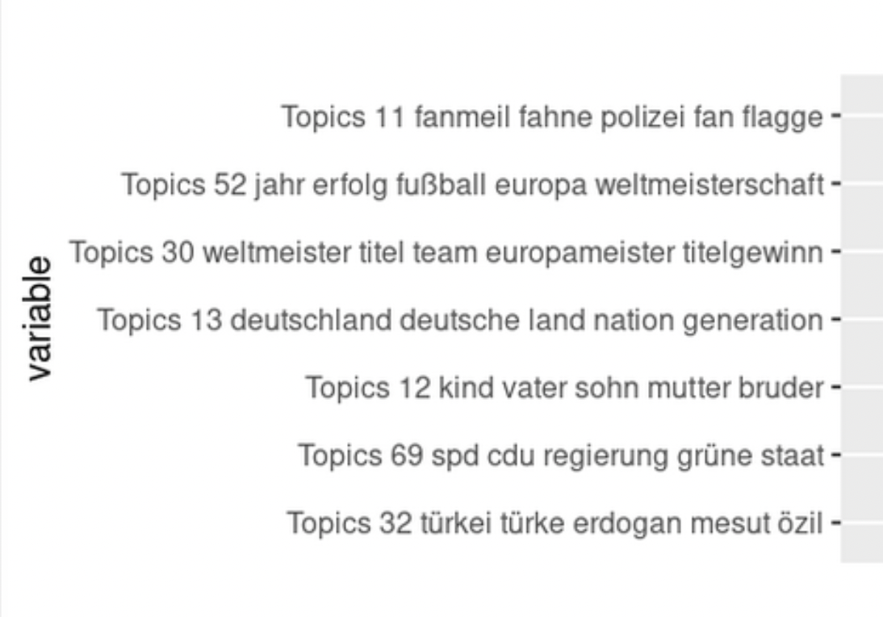
4. Preliminary Results - A Closer Look…

Slide 21
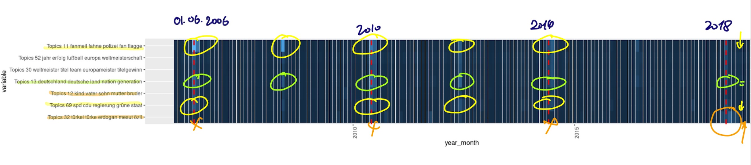
4. Preliminary Results - A Closer Look…

Slide 22

5. Questions and Discussion
Summary:
Building a customized corpus
Topic modeling + identifying interesting topics
Correlating topics with time series
Next steps?
Identifying articles that require close reading based on topics
Finding more evidences in the corpus to answer my research questions
…

